Slide 1
UCJ
CREDIT CARD

Slide 2
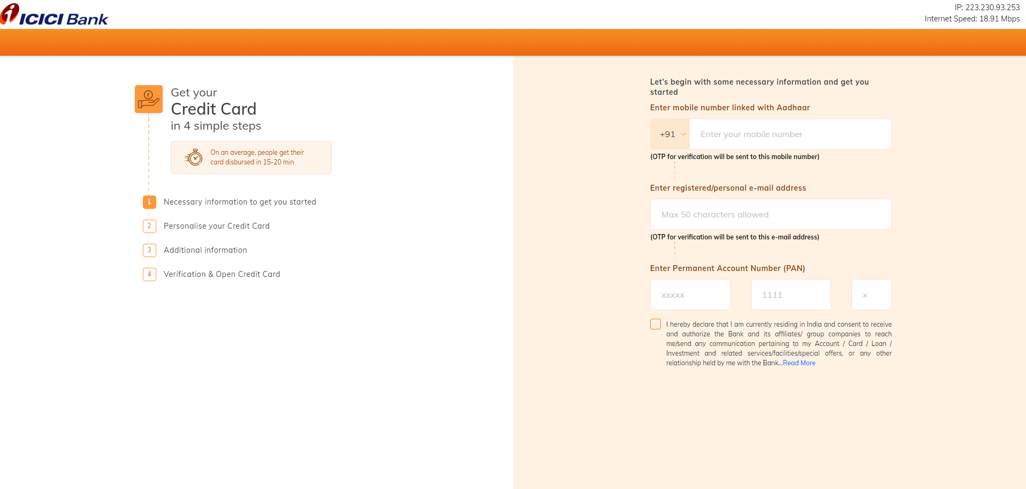
User entry of Basic details

Slide 3
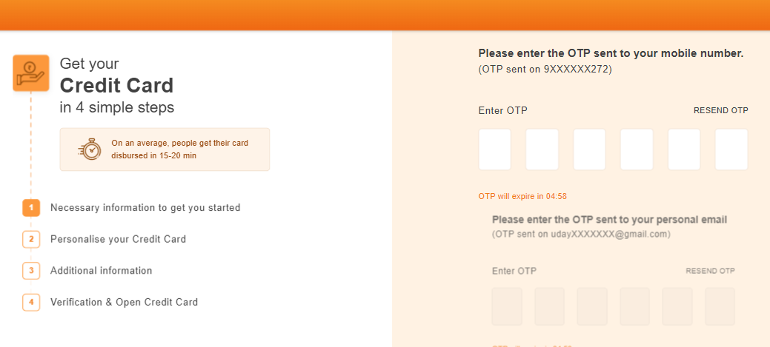
OTP sent to your Mobile number & personal email ID

Slide 4
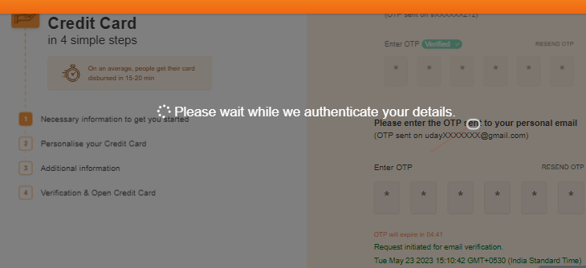
OTP verification

Slide 5
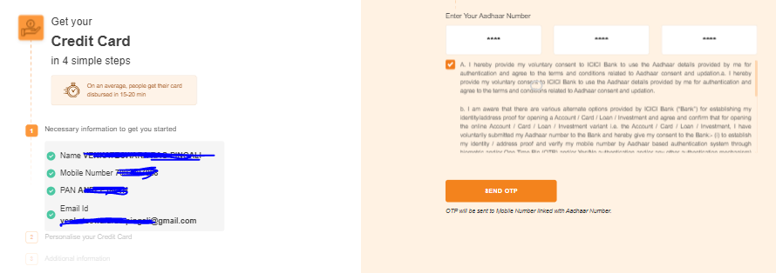
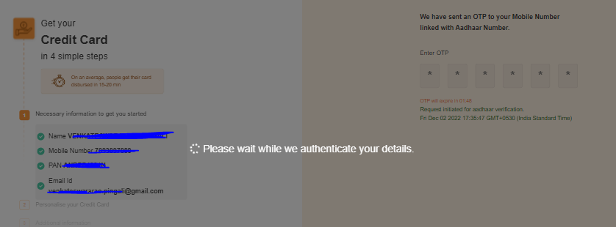
Aadhar verification page (KYC red customers) - OTP sent to your Aadhar linked Mobile number

Slide 6
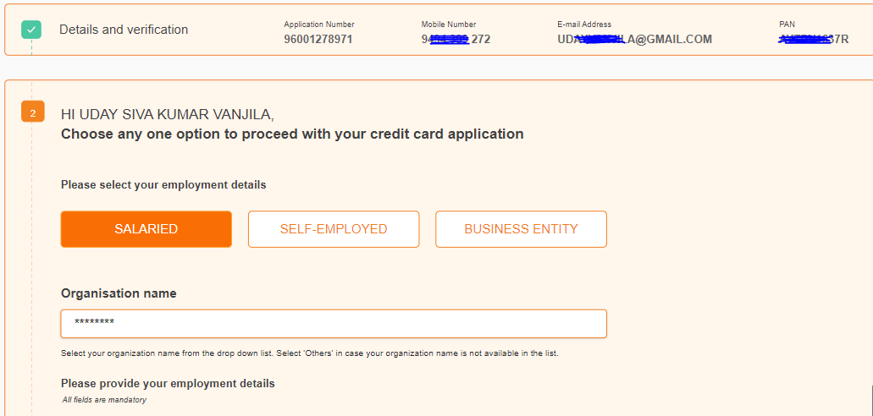
BRE1 output - Details filling page shown for Non-Hard Reject cases
*Salaried & Organisation name auto-filled for MCCM customers
*Self-employed & Business Entity drop out on this page after filling details

Slide 7
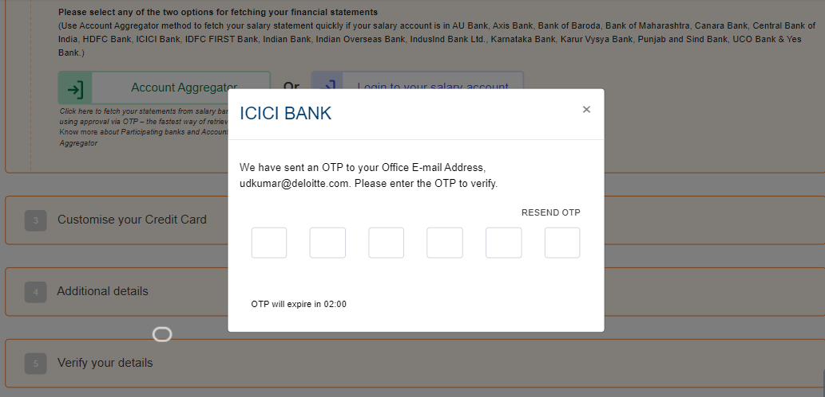
Official Email ID verification OTP – After clicking on either option (AA/NB)

Slide 8
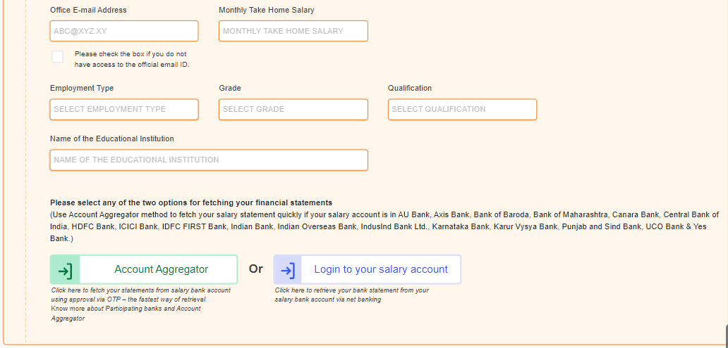
Details filling page (Contd.)

Slide 9
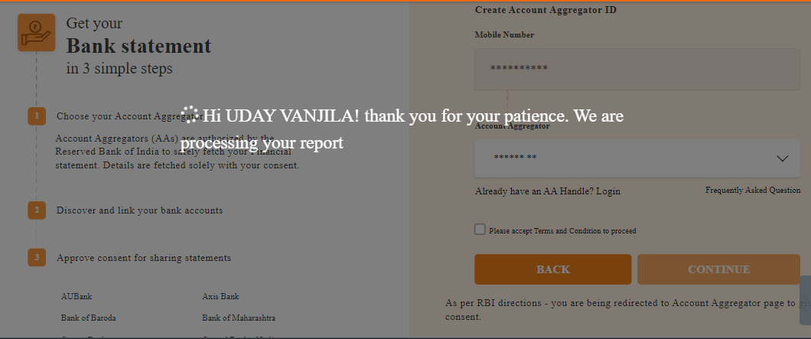
Account aggregator page

Slide 10
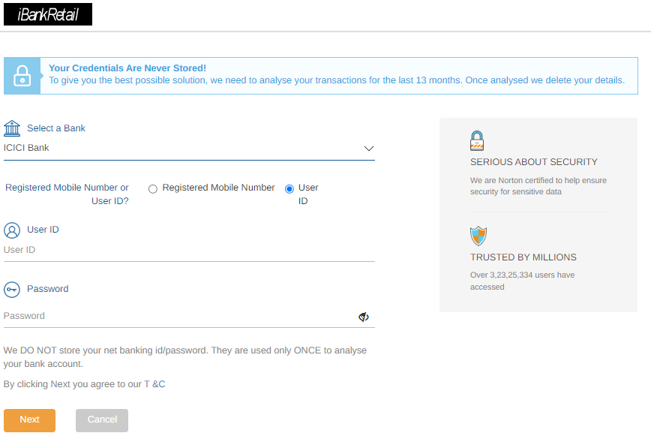
Net banking login page

Slide 11
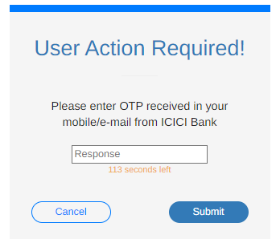
OTP verification

Slide 12
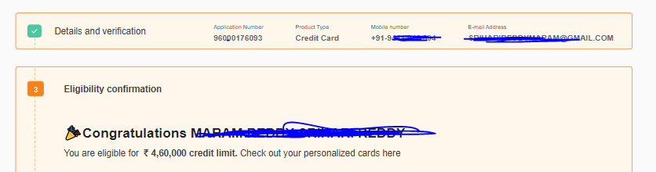
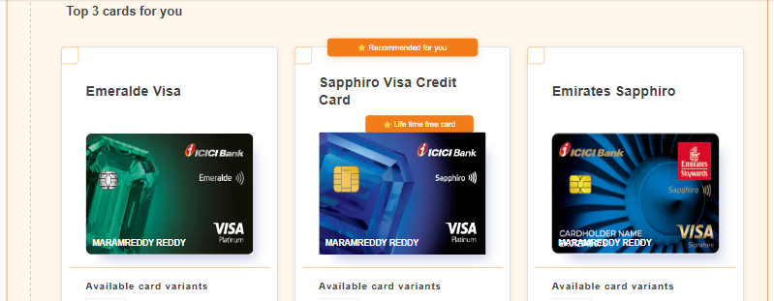
BRE2 output - Card Selection Page shown for RC/STP customers
*Non-Affluent & LC customers drop out before reaching this page

Slide 13
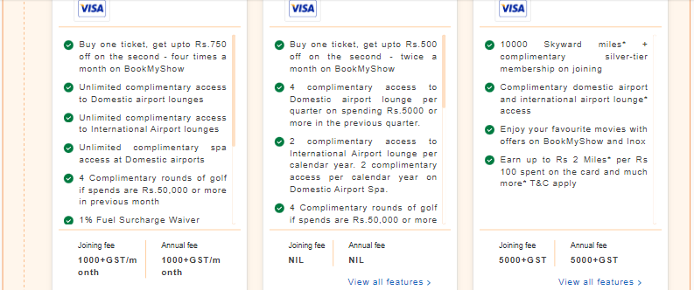
Card Selection Page

Slide 14
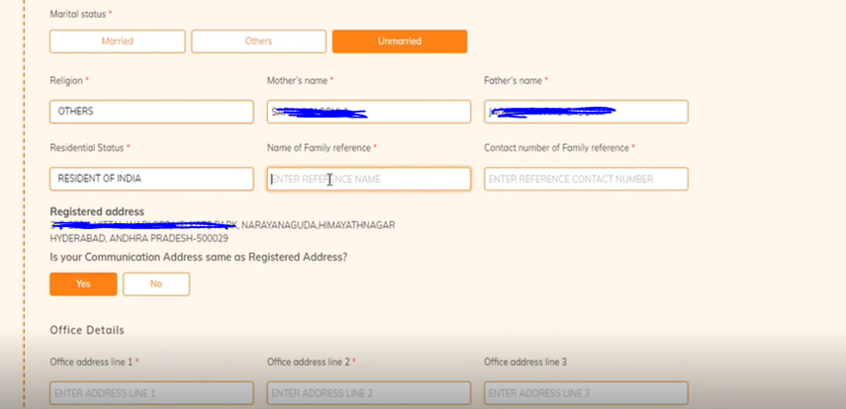
Additional details filling page

Slide 15
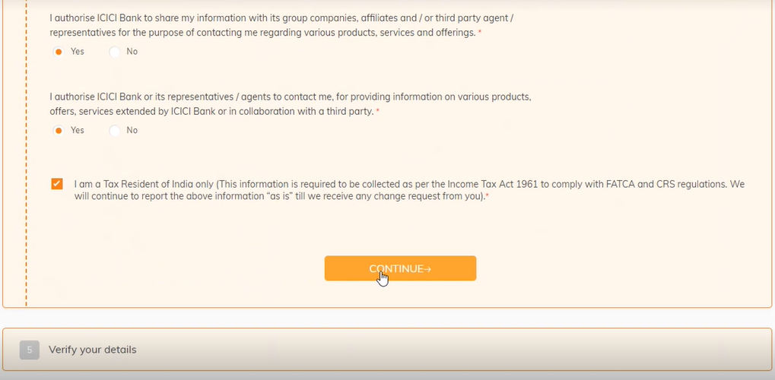
Additional details filling page - Consent/Declaration

Slide 16
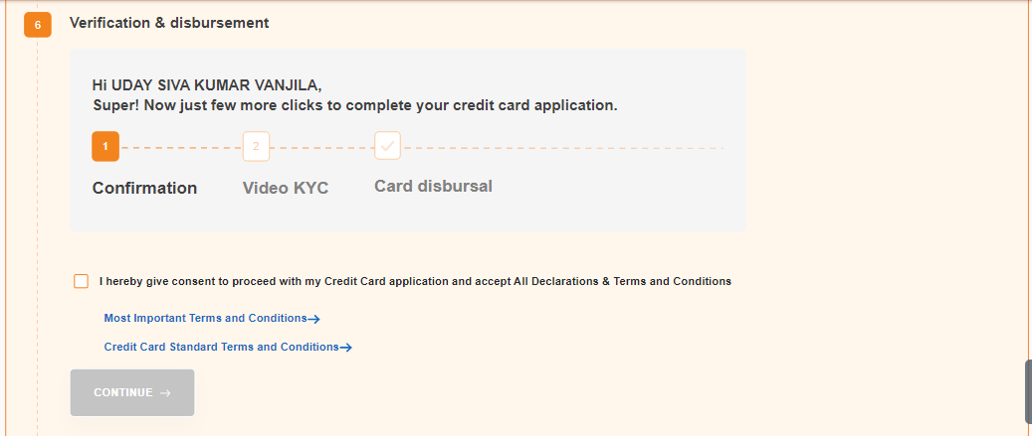
Confirmation page

Slide 17
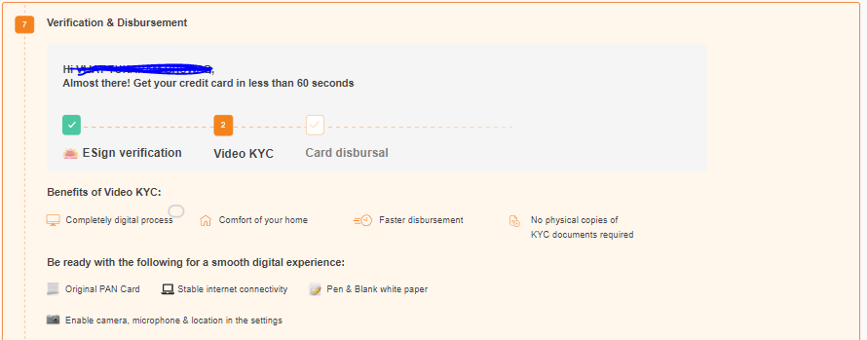
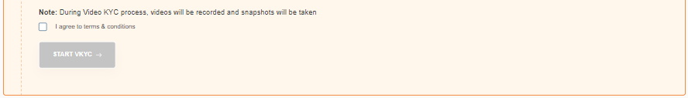
VKYC Initiate page

Slide 18
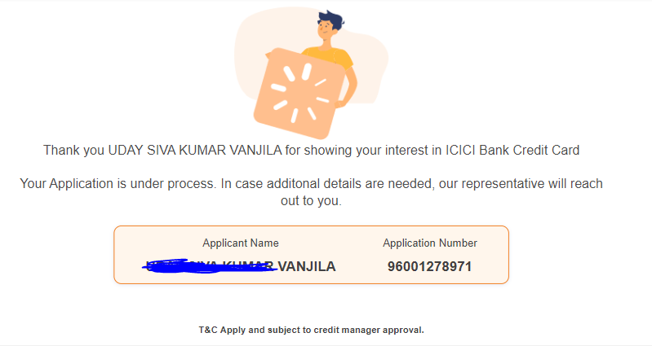
Final Thank you screen

Slide 19
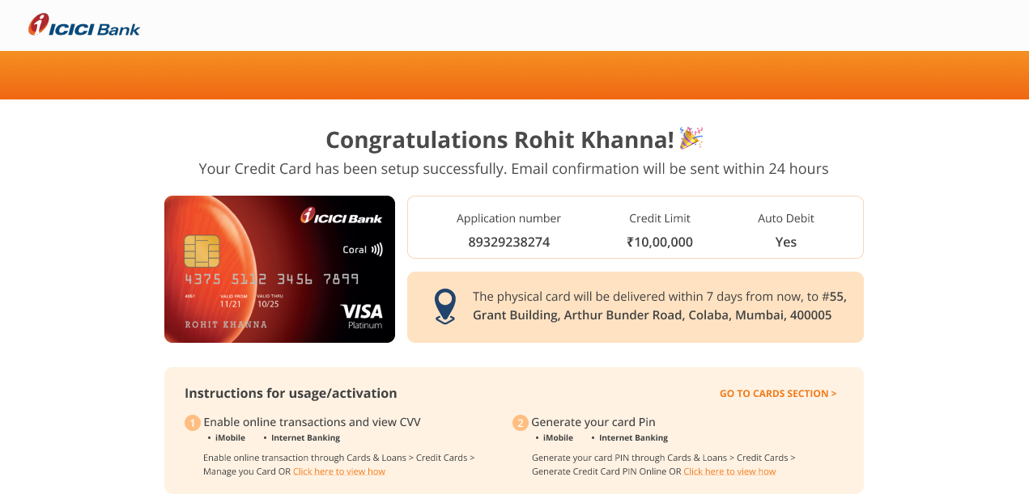
Prime Success Screen (under dev)

Slide 20
Thank You

